Slide 1

Chapter 11
Monopoly
and Monopsony

Slide 2
Chapter Eleven Overview
The Monopolist’s Profit Maximization Problem
The Profit Maximization Condition
Equilibrium
The Inverse Pricing Elasticity Rule
2. Multi-plant Monopoly and Cartel Production
The Welfare Economics of Monopoly
Chapter Eleven

Slide 3
A Monopoly
Definition: A Monopoly Market consists of a single seller facing many buyers.
The monopolist's profit maximization problem:
Max π(Q) = TR(Q) - TC(Q) Q
where: TR(Q) = QP(Q) and P(Q) is the (inverse) market demand curve.
The monopolist's profit maximization condition:
ΔTR(Q)/ΔQ = ΔTC(Q)/ΔQ
MR(Q) = MC(Q)
Chapter Eleven

Slide 4
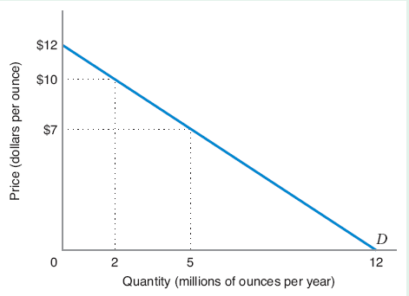
A Monopoly – Profit Maximizing
Monopolist’s demand Curve is downward-sloping
Along the demand curve, different revenues for different quantities
Profit maximization problem is the optimal trade-off between volume (number of units sold) and margin (the differential between price).
Chapter Eleven

Slide 5
A Monopoly – Profit Maximizing
Demand Curve:
Total Revenue:
Total Cost (Given):
Profit-Maximization: MR = MC
Chapter Eleven

Slide 6
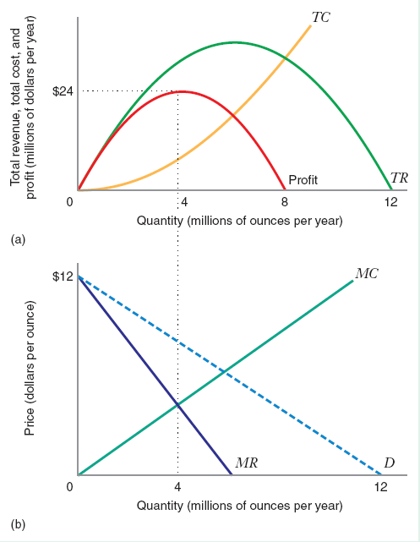
A Monopoly – Profit Maximizing
As Q increases TC increases, TR increases first and then decreases.
Profit Maximization is at MR = MC
Chapter Eleven

Slide 7
A Monopoly – Profit Maximizing
MR>MC, firm can increase Q and increase profit
MR<MC, firm can decrease quantity and increase profit
MR=MC , firm cannot increase profit.
Profit Maximizing Q:
Chapter Eleven

Slide 8
Marginal Revenue
Price
Price
Competitive Firm Monopolist
Demand facing firm
Demand facing firm
P₀
P₀
C
P₁
A
B
A
B
q q+1
Firm output
Q₀
Q₀+1
Firm output
Chapter Eleven

Slide 9
Marginal Revenue Curve and Demand
Price
The MR curve lies below the demand curve.
P(Q₀)
MR(Q₀)
P(Q), the (inverse) demand curve
MR(Q), the marginal revenue curve
Q₀
Quantity
Chapter Eleven

Slide 10
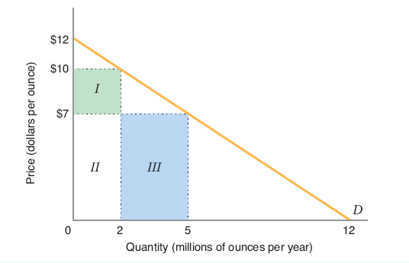
Marginal Revenue Curve and Demand
To sell more units, a monopolist has to lower the price.
Increase in rev. is Area III while revenue sacrificed on higher price units is Area I
Change in TR equals area III – area I
Chapter Eleven

Slide 11
Marginal Revenue Curve and Demand
Area III = price x change in quantity = P(ΔQ)
Area I = - quantity x change in price = -Q (ΔP)
Change in monopolist profit: P(ΔQ) + Q (ΔP)
Chapter Eleven

Slide 12
Marginal Revenue
Marginal revenue has two parts:
P: increase in revenue due to higher volume-the marginal units
Q(ΔP/ΔQ): decrease in revenue due to reduced price of the inframarginal units.
The marginal revenue is less than the price the monopolist can charge to sell that quantity for any Q>0
Chapter Eleven

Slide 13
Average Revenue
Since
The price a monopolist can charge to sell quantity Q is determined by the market demand curve the monopolists’ average revenue curve is the market demand curve.
Chapter Eleven

Slide 14
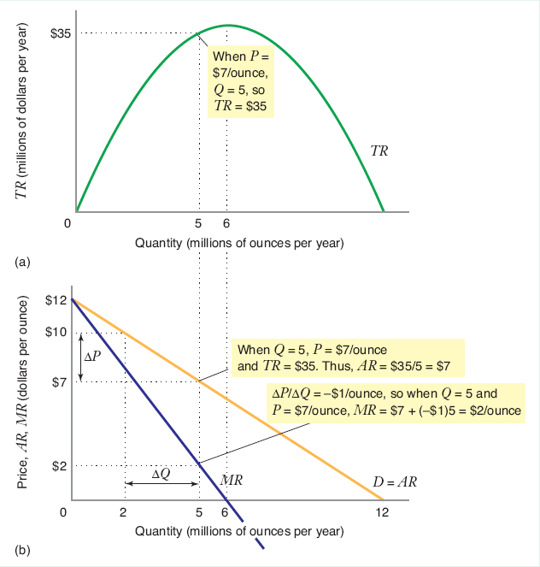
Marginal Revenue and Average Revenue
The demand curve D and average revenue curve AR coincide
The marginal revenue curve MR lies below the demand curve
Chapter Eleven

Slide 15
Marginal Revenue and Average Revenue
When P decreases by $3 per ounce, (from $10 to $7), quantity increases by 3 million ounces (from 2 million to 5 million per year)
Chapter Eleven

Slide 16
Marginal Revenue and Average Revenue
Conclusions if Q > 0:
MR < P
MR < AR
MR lies below the demand curve.
Chapter Eleven

Slide 17
Marginal Revenue and Average Revenue
Given the demand curve, what are the average and marginal revenue curves?
Vertical intercept is
Horizontal intercept is
Chapter Eleven

Slide 18
Profit Maximization
Given the inverse demand and MC, what is the profit maximizing Q and P for the monopolist?
Chapter Eleven

Slide 19
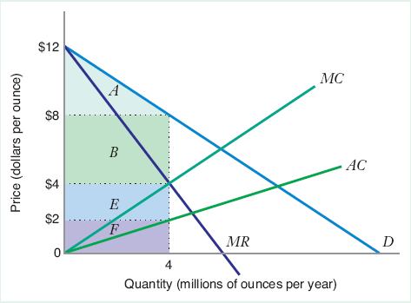
Profit Maximization
Profit Maximizing output is at MR=MC
Monopolist will make 4 million ounces and sells at $8 per ounce
TR = Areas B + E + F
Profit (TR-TC) is B + E
Consumer surplus is area A
Chapter Eleven

Slide 20
Shutdown Condition
In the short run, the monopolist shuts down if the most profitable price does not cover AVC. In the long run, the monopolist shuts down if the most profitable price does not cover AC. Here, P* exceeds both AVC and AC.
Chapter Eleven

Slide 21
Positive Profits for Monopolist
This profit is positive. Why? Because the monopolist takes into account the price-reducing effect of increased output so that the monopolist has less incentive to increase output than the perfect competitor.
Profit can remain positive in the long run. Why? Because we are assuming that there is no possible entry in this industry, so profits are not competed away.
Chapter Eleven

Slide 22
Equilibrium
A monopolist does not have a supply curve (i.e., an optimal output for any exogenously-given price) because price is endogenously-determined by demand: the monopolist picks a preferred point on the demand curve.
One could also think of the monopolist choosing output to maximize profits subject to the constraint that price be determined by the demand curve.
Chapter Eleven

Slide 23
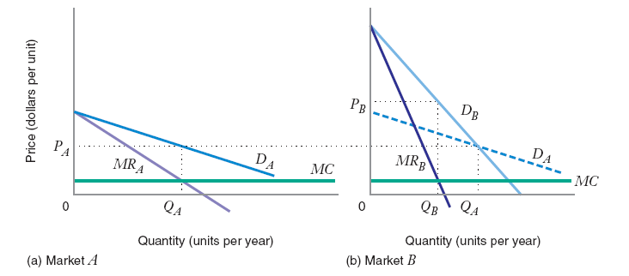
Price Elasticity of Demand
Market A profit maximizing price is P_{A}.
Market B profit maximizing price is P_{B}. Demand is less elastic in Market B
Chapter Eleven

Slide 24
Inverse Elasticity Pricing Rule
We can rewrite the MR curve as follows:
MR = P + Q(ΔP/ΔQ)
= P(1 + (Q/P)(ΔP/ΔQ))
= P(1 + 1/ε)
where: ε is the price elasticity of demand, (P/Q)(ΔQ/ΔP)
Chapter Eleven

Slide 25
Inverse Elasticity Pricing Rule
Using this formula:
When demand is elastic (ε < -1), MR > 0
When demand is inelastic (ε > -1), MR < 0
When demand is unit elastic (ε = -1), MR= 0
Chapter Eleven

Slide 26
Inverse Elasticity Pricing Rule
Given the constant elasticity demand curve and MC:
What is the optimal P when Q = 100P⁻²?
What is the optimal P when Q = 100P⁻⁵?
Chapter Eleven

Slide 27
Elasticity Region of the Linear Demand Curve
Price
a
Elastic region (ε < -1), MR > 0
Unit elastic (ε=-1), MR=0
Inelastic region (0>ε>-1), MR<0
Quantity
a/2b a/b
Chapter Eleven

Slide 28
Marginal Cost and Price Elasticity Demand
Profit maximizing condition is MR = MC with P* and Q*
Rearranging and setting MR(Q*) = MC(Q*)
Chapter Eleven

Slide 29
Inverse Elasticity Pricing Rule
Inverse Elasticity Pricing Rule: Monopolist’s optimal markup of price above marginal cost expressed as a percentage of price is equal to minus the inverse of the price elasticity of demand.
Chapter Eleven

Slide 30
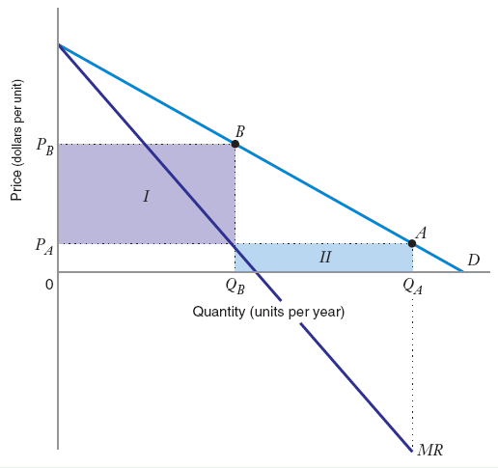
Price Elasticity
Monopolist operates at the elastic region of the market demand curve. Increasing price from PA to PB, TR increases by area I – area II and total cost goes down because monopolist is producing less
Chapter Eleven

Slide 31
Elasticity Region of the Demand Curve
Therefore:
The monopolist will always operate on the elastic region of the market demand curve As demand becomes more elastic at each point, marginal revenue approaches price
Chapter Eleven

Slide 32
Elasticity Region of the Demand Curve
Example:
Now, suppose that Q_{D} = 100P^{-b} and MC = c (constant). What is the monopolist's optimal price now?
P(1+1/-b) = c
P* = cb/(b-1)
We need the assumption that b > 1 ("demand is everywhere elastic") to get an interior solution.
As b -> 1 (demand becomes everywhere less elastic),
P* -> infinity and P - MC, the "price-cost margin" also increases to infinity.
As b -> ∞, the monopoly price approaches marginal cost.
Chapter Eleven

Slide 33
Market Power
Definition: An agent has Market Power if s/he can affect, through his/her own actions, the price that prevails in the market. Sometimes this is thought of as the degree to which a firm can raise price above marginal cost.
Chapter Eleven

Slide 34
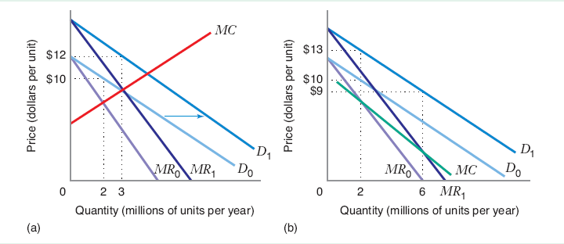
Comparative Statics – Shifts in Market Demand
Rightward shift in the demand curve causes an increase in profit maximizing quantity.
(a) MC is increases as Q increases
(b) MC decreases as Q increases
Chapter Eleven

Slide 35
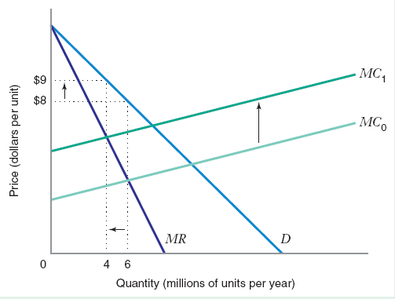
Comparative Statics – Shifts in Marginal Cost
When MC shifts up, Q falls and P increases.
Chapter Eleven

Slide 36
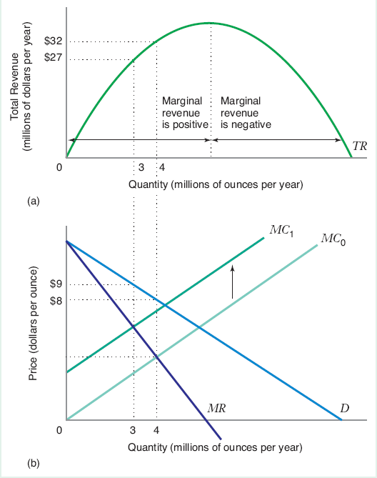
Comparative Statics – Revenue and MC shifts
Upward shift of MC decreases the profit maximizing monopolist’s total revenue.
Downward shift of MC increases the profit maximizing monopolist’s total revenue.
Chapter Eleven

Slide 37
Multi-Plant Monopoly
Recall:
In the perfectly competitive model, we could derive firm outputs that varied depending on the cost characteristics of the firms. The analogous problem here is to derive how a monopolist would allocate production across the plants under its management.
Assume:
The monopolist has two plants: one plant has marginal cost MC₁(Q) and the other has marginal cost MC₂(Q).
Chapter Eleven

Slide 38
Multi-Plant Monopoly – Production Allocation
Whenever the marginal costs of the two plants are not equal, the firm can increase profits by reallocating production towards the lower marginal cost plant and away from the higher marginal cost plant.
Example:
Suppose the monopolist wishes to produce 6 units
3 units per plant with
MC₁ = $6
MC₂ = $3
Reducing plant 1's units and increasing plant 2's units raises profits
Chapter Eleven

Slide 39
Multi-Plant Monopoly – Production Allocation
Price
MC₁
MC_{T}
•
6
Example: Multi-Plant Monopolist
This is analogous to exit by higher cost firms and an increase in entry by low-cost firms in the perfectly competitive model.
3
Quantity
3 6 9
Chapter Eleven

Slide 40
Multi-Plant Monopoly – Production Allocation
MC₂
Price
MC₁
MC_{T}
•
6
Example: Multi-Plant Monopolist
This is analogous to exit by higher cost firms and an increase in entry by low-cost firms in the perfectly competitive model.
•
3
Quantity
3 6 9
Chapter Eleven

Slide 41
Multi-Plant Marginal Costs Curve
Question: How much should the monopolist produce in total?
Definition: The Multi-Plant Marginal Cost Curve traces out the set of points generated when the marginal cost curves of the individual plants are horizontally summed (i.e. this curve shows the total output that can be produced at every level of marginal cost.)
Example:
For MC₁ = $6, Q₁ = 3
MC₂ = $6, Q₂ = 6
Therefore, for MC_{T} = $6, Q_{T} = Q₁ + Q₂ = 9
Chapter Eleven

Slide 42
Multi-Plant Marginal Costs Curve
The profit maximization condition that determines optimal total output is now:
MR = MC_{T}
The marginal cost of a change in output for the monopolist is the change after all optimal adjustment has occurred in the distribution of production across plants.
Chapter Eleven

Slide 43
Multi-Plant Monopolistic Maximization
Price
MC₁
MC₂
MC_{T}
P*
MR
Quantity
Chapter Eleven

Slide 44
Multi-Plant Monopolistic Maximization
Price
MC₁
MC₂
MC_{T}
P*
Demand
MR
Quantity
Q*₁ Q*₂ Q*_{T}
Chapter Eleven

Slide 45
Multi-Plant Monopolistic Maximization
Example:
P = 120 - 3Q …demand…
MC₁ = 10 + 20Q₁ …plant 1…
MC₂ = 60 + 5Q₂ …plant 2…
What are the monopolist's optimal total quantity and price?
Step 1: Derive MC_{T} as the horizontal sum of MC₁ and MC₂. Inverting marginal cost (to get Q as a function of MC), we have:
Q₁ = -1/2 + (1/20)MC_{T}
Q₂ = -12 + (1/5)MC_{T}
A
Chapter Eleven

Slide 46
Multi-Plant Monopolistic Maximization
Let MC_{T} equal the common marginal cost level in the two plants. Then:
Q_{T} = Q₁ + Q₂ = -12.5 + .25MC_{T}
And, writing this as MC_{T} as a function of Q_{T}:
MC_{T} = 50 + 4Q_{T}
Using the monopolist's profit maximization condition:
MR = MC_{T} => 120 - 6Q_{T} = 50 + 4Q_{T}
Q_{T}* = 7
P* = 120 - 3(7) = 99
Chapter Eleven

Slide 47
Multi-Plant Monopolistic Maximization
Example:
P = 120 - 3Q …demand…
MC₁ = 10 + 20Q₁ …plant 1…
MC₂ = 60 + 5Q₂ …plant 2…
What is the optimal division of output across the monopolist's plants?
MC_{T}* = 50 + 4(7) = 78
Therefore,
Q₁* = -1/2 + (1/20)(78) = 3.4
Q₂* = -12 + (1/5)(78) = 3.6
B
Chapter Eleven

Slide 48
Cartel
Definition: A cartel is a group of firms that collusively determine the price and output in a market. In other words, a cartel acts as a single monopoly firm that maximizes total industry profit.
Chapter Eleven

Slide 49
Cartel
The problem of optimally allocating output across cartel members is identical to the monopolist's problem of allocating output across individual plants.
Therefore, a cartel does not necessarily divide up market shares equally among members: higher marginal cost firms produce less.
This gives us a benchmark against which we can compare actual industry and firm output to see how far the industry is from the collusive equilibrium
Chapter Eleven

Slide 50
The Welfare Economies of Monopoly
Since the monopoly equilibrium output does not, in general, correspond to the perfectly competitive equilibrium it entails a dead-weight loss.
Suppose that we compare a monopolist to a competitive market, where the supply curve of the competitors is equal to the marginal cost curve of the monopolist
Chapter Eleven

Slide 51
The Welfare Economies of Monopoly
CS with competition: A+B+C ; CS with monopoly: A
PS with competition: D+E ; PS with monopoly: B+D
A
MC
P^{M}
B
C
DWL = C+E
P^{C}
E
D
Demand
Q^{M}
Q^{C}
MR
Chapter Eleven

Slide 52
Natural Monopolies
Definition: A market is a natural monopoly if the total cost incurred by a single firm producing output is less than the combined total cost of two or more firms producing this same level of output among them.
Benchmark: Produce where P = AC
Chapter Eleven

Slide 53
Natural Monopolies
Price
Natural Monopoly falling average costs
AC
Demand
Quantity
Chapter Eleven

Slide 54
Barriers to Entry
Definition: Factors that allow an incumbent firm to earn positive economic profits while making it unprofitable for newcomers to enter the industry.
Structural Barriers to Entry – occur when incumbent firms have cost or demand advantages that would make it unattractive for a new firm to enter the industry
Legal Barriers to Entry – exist when an incumbent firm is legally protected against competition
Strategic Barriers to Entry – result when an incumbent firm takes explicit steps to deter entry
Chapter Eleven

Slide 55
A Monopsony
Definition: A Monopsony Market consists of a single buyer facing many sellers.
The monopsonist's profit maximization problem:
Max π = TR – TC = P*f(L) – w*L
where: Pf(L) is the total revenue for the monopsonist and w*L is the total cost.
The monopsonist's profit maximization condition:
MRP_{L} = P*MP_{L} = P (ΔQ/ΔL)
= ΔTC/ΔL = w + L (Δw/ΔL) = ME_{L}
Chapter Eleven

Slide 56
Monopsony - Example
Q = 5L
P = $10 per unit
w = 2 + 2L
ME_{L} = w + L (Δw/ΔL) = 2 + 4L
MRP_{L} = P*(ΔQ/ΔL) = 10*5 = 50
ME_{L} = MRP_{L}
2 + 4L = 50 (or) L = 12
W = 2 + 2L = $26
Chapter Eleven

Slide 57
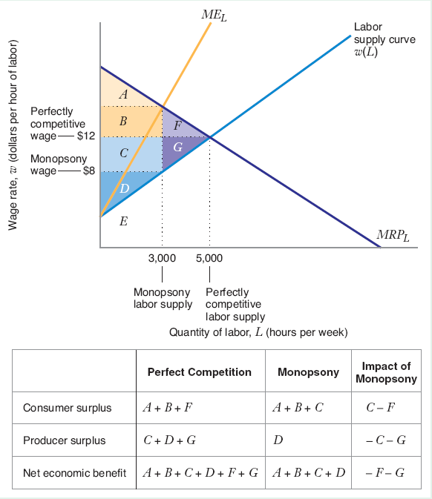
The Welfare Economies of Monopsony
Chapter Eleven

